Slide 1

Generating Realistic Text with Markov Models
This presentation explores the fascinating world of Markov Models and their application to text generation. We'll dive into the concepts, implementation, and challenges involved in creating realistic and engaging text using this powerful technique.
Notes:
1

Slide 2
Introduction to Markov Models
Foundation of Markov Chains
Applications in Various Fields
Markov chains are mathematical models that describe a sequence of events, where the probability of each event depends only on the previous event. This simple yet powerful principle forms the basis of Markov Models.
Markov models are widely used in areas like finance, weather forecasting, and natural language processing, offering insights into complex sequences of data.
Notes:
2

Slide 3
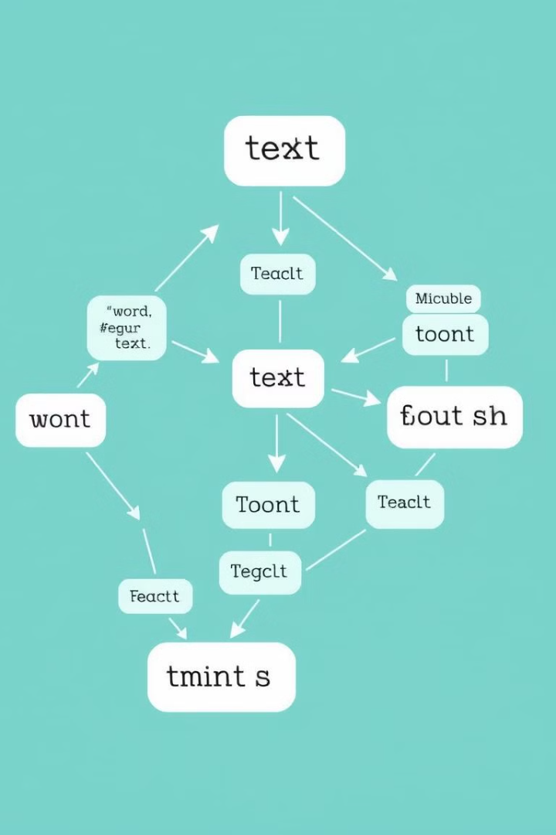

Applying Markov Models to Text Generation
1
1. Tokenization
2
2. Probability Calculation
The text is broken down into individual units, or tokens, like words or characters. This creates a sequence of tokens that the model can analyze.
The model analyzes the frequencies of token sequences and calculates the probabilities of transitioning between different tokens.
3
3. Text Generation
Using the learned probabilities, the model generates new text by predicting the next token based on the previous ones, creating a coherent and realistic output.
Notes:
3

Slide 4
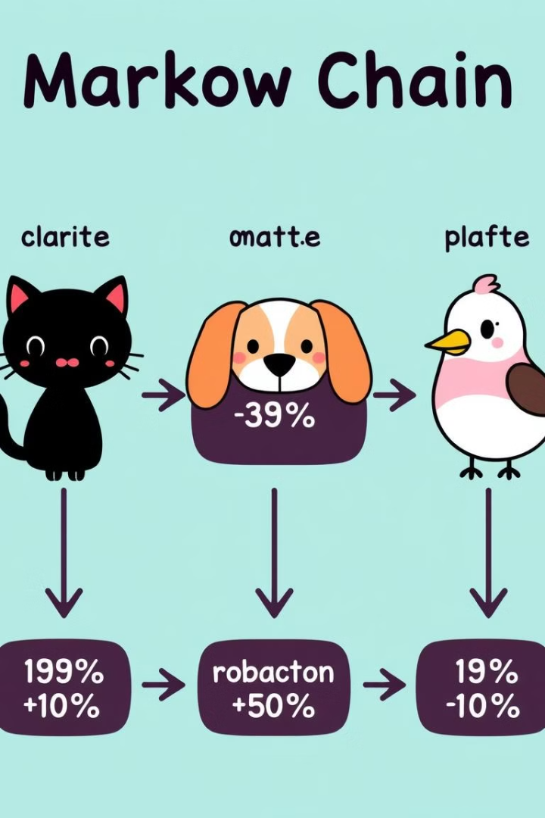



Visualizing Markov Chain
Initial State
The process begins with a starting state.
Transition 1
The model transitions to another state based on the calculated probabilities.
Transition 2
The process continues with further transitions, following the defined probabilities.
Notes:
4

Slide 5

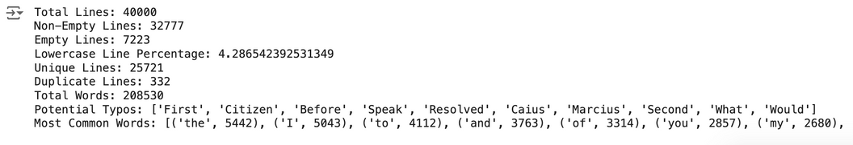
Data Quality
Relevance
Size
The data must be relevant to the desired style and genre of text. For example, using a dataset of Shakespearean plays to generate poetry is unlikely to produce desirable results.
A larger dataset generally leads to more accurate and diverse text generation. However, the quality of the data is more important than its sheer size.
Diversity
A diverse dataset with various writing styles, vocabulary, and sentence structures will result in richer and more engaging text generation.
Notes:
5

Slide 6



Evaluating Text Generation Quality
Davis Bounded Index
Silhouette Score
Evaluates the compactness of clusters. A higher score indicates well-separated clusters, implying more consistent text generation.
Davies-Bouldin Index: 2.6000856343203367
Measures how similar a point is to its own cluster compared to other clusters. A higher score means better cluster separation and higher text generation quality.
Silhouette Score: 0.16698863560520166
Notes:
6

Slide 7
Handling Common Issues in Text Generation
Repetitive Text
1
Using techniques like backoff smoothing or incorporating context can mitigate the issue of repetitive text generation.
Lack of Coherence
2
Utilizing higher-order Markov chains, where more than one preceding token influences the prediction, can improve coherence.
Inaccurate Grammar
3
Fine-tuning the model with grammatical constraints or applying post-processing techniques can ensure correct grammar.
Notes:
7

Slide 8

Practical Applications and Future Developments
1
Chatbots
Markov Models play a crucial role in developing realistic and engaging chatbots that can simulate human conversation.
2
Content Creation
They can be used for generating articles, stories, and other forms of content, offering writers a valuable tool for creativity.
3
Personalized Experiences
Markov models can be used to create customized experiences, like personalized recommendations and targeted advertising.
Notes:
8

